Slide 1
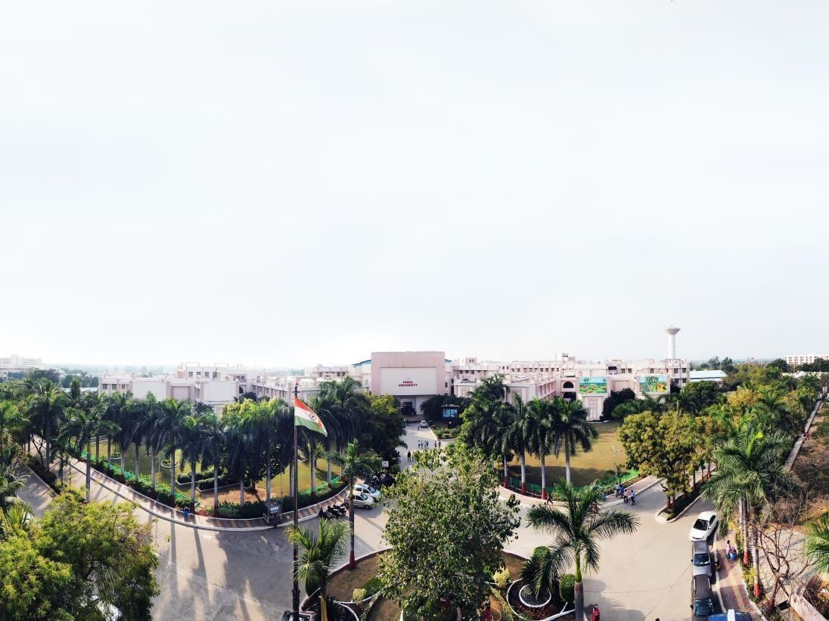


JSP
Gaurav Pimplekar
IT Trainer

Slide 2
JSP: Java Server Page Introduction
Jsp is a technology based on the java language and enables the development of dynamic web sites.
Jsp was developed by Sun microsystems to allow us to server side development
A JSP page is textual document that describes how to create a response object from request object for given protocol
The main goal of JSP technology is to simplify the certain task and maintenance of server side html pages.
A JSP page contains standard mark-up elements such as HTML tags just like a regular web pages. And it contains special JSP elements that allows the server to insert dynamic content in the page.
The Phases of JSP page
JSP Page
(.jsp file)
Translated to
Servlet Code
(.java file)
Complied to
Java Class
(.class file)

Slide 3
The problem with servlet
Programming with servlets is a very boring and continuing for long time as a servlets not only handle the request processing and business logic but also the presentation task.
It is a common fact that servlets incorporate both the processing logic and presentation logic.
In the servlet, every single change In the presentation logic of an application, requires the servlet programmer to
Update the servlets code and compile it.
Web page development tools do not directly support servlets when do signing application
Due to this problems, sun microsystems developed JSP technology.

Slide 4
JSP
With JSP technology, the presentation logic may contain both static and dynamic content thereby making the web development vary easy and flexible.
In JSP technology, the business logic and request process logic are separated from presentation logic.
JSP provides a very powerful and flexible mechanism to provide dynamic web pages.
JSP doesn’t require any special setup at the client-side
JSP provides built in supports for HTTP session management.
JSP is compiled can automatically compiled when necessary for efficient server processing.

Slide 5
JSP
JSP can be integrated with enterprise java
Jdbc API
Thread API
EJB API
Web development tools gives full support to JSP because JSP pages are like HTML pages.

Slide 6
JSP page anatomy
The JSP page is almost like a regular web page with the inclusion of dynamic behaviour through JSP elements.

Slide 7
JSP Elements
These are the things that the JSP coutines understands and translates. Hence we can say that JSP elements instracuts the JSP container, what code to generate and how it should operate.
Template Data := Everything else in the page that the JSP container does not understand Is called template data.

Slide 8
JSP Elements Example
<%@ page import=“java.util.Data” session=“false”%>
<html>
<head>
<title>Simple JSP page </title>
</head>
<body>
<h3>current time is :</h3>
<%=new Date %>
</body>
</html>

Slide 9
JSP Elements
All the jsp elements may be written in one or two forms.
1) xml form
2) <%...%> form

Slide 10
JSP Elements types
These are four types of JSP elements, they are
Directive Elements
Scripting Elements
Action Elements
Expression Language Enpressions.

Slide 11
Directive Elements
Directive gives massage to JSP container. During translation to generate the corresponding servlet and to control same characteristics of the jsp page.
Directive have the following general form
<%@ directive [ attribute = value, …] %>
These are three standard directives are
Page
Include
Taglib

Slide 12
Directive Elements
Page => It is used to specify current page settings as a whole
Syntax: <%@ page [ attribute = value, …] %>
2) Include => It is used to include content from other resources during the translation time
Syntax: <%@include file=“url” %>
3) Taglib => it is making use of custom actions defined in the tag library.
Syntax: <%@taglib uri=“liburi” prefin=“name” %>

Slide 13
Scripting Elements :-
Scripting elements enable programmers to embed code in another programming language
They age actually executed at request processing time and are used for a verify of purposes. Such as
To manipulated objects
To perform calculation on runtime values.
To perform computation on an object.
To declare methods or variables.

Slide 14
Scripting Elements :-
1)Script lets:- Script lets are the code fragments for a language which are executed at run time to process on http request
Script lets have following form:
<% java code %> or <% statements, [statements…]%>
2) Declarations:- Declaration enable a programmer to declare variables and methods of a language, which can be used from any point in the JSP page.
Unlike Script lets they cannot access JSP object
Declaration have following form:
<%! Statements, [statements…] %>

Slide 15
Scripting Elements :-
(C) Expressions:- Expressions enables a programmer to write express a language which gets evaluated at request processing used to insert values directly inti in time. These are the output.
It has following tom:
<%= expression %>

Slide 16
Action Elements :-
3) Action Elements:- Specific functionality is encapsulated by action elements in predestined toys, to be used by programmer in Jsp page.
At translation time these actions elements are replaced by Java code which corresponds to specify Functionality.
The action elements can dynamically generating HTML,

Slide 17
JSP Processing
* JSP processing:-
Any webserver needs a container to run any web component to provide interface to run web component.
A Jsp page needs processed. a Jsp container to be
Generally Speaking a Jsp container acts as a mediator between the Jsp page and the server by taking all Jsp requests and to produce the response
JSP Page
(.jsp file)
Translated to
Servlet Code
(.java file)
Complied to
Java Class
(.class file)

Slide 18
JSP Processing
Converting Jsp page to a servlet (java file) and Compiling Servlet is called "translation phase"..
The Jsp container is also responsible for invoking Jsp page implementation to process each request and generate the response. converting the servlet code to class file is called as "Request processing phase”.

Slide 19
MVC
Model-view-controller (MVC) is a design pattern. introduced by Xerox PARC (palo Alto Research Center) in The 1980'5.
MVC is a model used in swing components. The Main aspect of MVC is to divide the applications into area distinct but interrelated units.
these are :-
Model:- This is the business logic of applications
responsible for performing the actual work conducted by application.
Hence we can say that this unit deals with the Modeling of real-world problem and doesn't have any Idea about how it is being display to the user.

Slide 20
MVC
View: This is the presentation logic of an application and represent appearance of the information
It may have little in no programming logic at all.
Controller: This is the request processing logic of an application, mainly responsible for coupling both model and the view together as to perform Some operation.

Slide 21
Database programming using JDBC:-
JDBC APIs are used by a Java application to Communicate with a database.
In other words, we use JDBC to communicate with a database, and the Communicate implemented by JDBC API.
The JDBC application-specific code should be written with in an The database. application that has to communicate

Slide 22
Database programming using JDBC:-
There are some basic steps in JDBC connectivity-
thole are
Step1
Obtaining a Connection
Step 2
Creating a DBC Statement
Step 3
Exciting SQL Statements
Step 4
Closing the Connection.

Slide 23
Thank you!

Slide 24


www.paruluniversity.ac.in

